Slide 1
Determining the sanction
Miller-Becker Seminar
October 20, 2023

Slide 2
Participation instructions
Make sure your cell phone is connected to OSBAWifi
Open menti.com in your phone’s browser
When prompted, enter the code 8612 3694
Follow on-screen prompts to vote
When voting:
Assume rule violations are proven
Consider weight you would give to aggravating/mitigating factors

Slide 3
Segment content
Five case scenarios
Simulated Panel/Board discussion
What do you think?
Actual case result

Slide 4
Scenario #1 impugning the judiciary

Slide 5
Impugning the judiciary
Multiple false and threatening statements to and about pro se parties and opposing counsel; false and unsubstantiated claims against judicial officers.
Denied any wrong-doing; verbally attacked relator’s counsel and panel chair; no remorse for conduct (“would do the same things again”).
Late for disciplinary hearings; unprepared and with no exhibits.

Slide 6
Sanction?
Fully-stayed suspension
One-year suspension
Two-year suspension
Indefinite suspension

Slide 8
Case results
ODC v. Cramer, 2020-Ohio-4195; Toledo Bar Assn. v. Yoder, 2020-Ohio-4774
Cramer’s conduct involved service as ancillary administrator of her mother’s estate and probate proceedings that continued after her removal. Sanction: Relator sought a one-year suspension; Board recommended and Court imposed an indefinite suspension.
Yoder’s conduct occurred in representing clients in two separate matters. Sanction: Board recommended two-year suspension with one year stayed; Court imposed Relator’s recommended sanction of two years with six months stayed.

Slide 9
Scenario #2
False notarization

Slide 10
False notarization
Respondent notarized documents for a client with diminished capacity. Delegated all client contact to non-attorney office manager.
Falsely notarized or signed as a witness seven estate-related documents; conduct was revealed in probate and malpractice litigation.

Slide 11
Sanction?
Fully-stayed suspension
Partially-stayed suspension
Actual suspension with no stay

Slide 13
Case result
ODC v. Jarvis, 2022-Ohio-3936
Parties stipulated to a two-year stayed suspension. Board rejected the stipulated sanction based on absence of precedent and recommended one-year stayed.
Court imposed 18-months, stayed based on a pattern of conduct and respondent’s failure to establish any professional relationship with a client known to have diminished capacity (dissent—18-months, one-year stayed)

Slide 14
Scenario #3 Sex-with-client

Slide 15
Sex-with-client
Respondent engaged in a sexual relationship with a client. The relationship continued for two years after the initial client-lawyer relationship ended.
After romantic relationship ended, the two remained friends for several years, and respondent represented the client in two other legal matters.
Respondent claimed the client initiated the relationship but acknowledged it was inappropriate.

Slide 16
Sanction?
Fully-stayed suspension
Partially-stayed suspension
Actual suspension with no stay

Slide 17
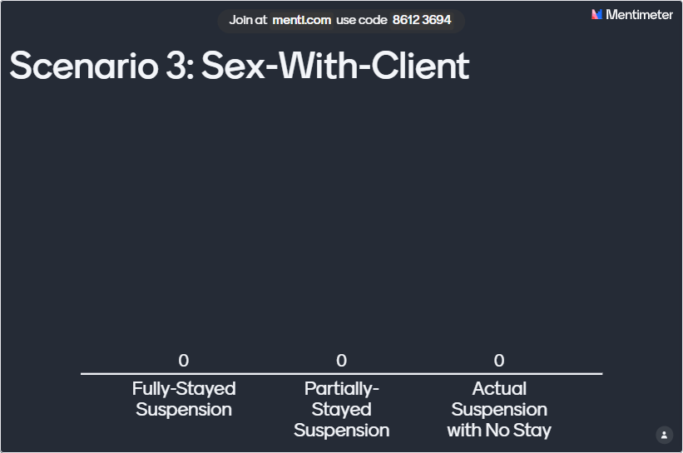

Slide 18
Case result
Akron Bar Assn. v. Fortado, 2020-Ohio-517; ODC v. Nowicki, 2023-Ohio-3079
Both Fortado and Nowicki entered into ostensibly consensual sexual relationships with clients and both had prior disciplinary offenses. Nowicki continued to represent his client and her husband after the affair commenced and represented her in divorce proceedings
Board recommended partially stayed suspensions; Court imposed one-year stayed.

Slide 19
Scenario #4 excessive fee; egregious conduct

Slide 20
Excessive fee; egregiousness
Respondent counseled client who was negotiating a settlement of a wrongful death claim involving the client’s minor daughter.
After the client successfully negotiated a seven-figure settlement, respondent undertook efforts to collect a contingency fee despite having spent just 15 hours advising the client.
Respondent threatened to have the client removed as administrator of daughter’s estate and filed an attorney fee application with the probate court.

Slide 21
Sanction?
Public reprimand
Fully-stayed suspension
Partially-stayed suspension
Actual suspension with no stay

Slide 23
Case result
ODC v. Amaddio & Wargo, 2020-Ohio-141
Parties recommended public reprimand
Board recommended a fully-stayed suspension
Court (5-2) imposed one-year suspensions based on respondents’ efforts to collect an excessive fee, attempts to coerce parents into complying with demands, and parents incurring $42,000 in attorney fees to fight fee demands

Slide 24
Scenario #5 Ex parte Communication

Slide 25
Ex parte communications
Respondent engaged in multiple ex parte communications via social media with a litigant.
Messages to the judge included information about the litigant’s pending custody matter, a request to have a protection order modified over objections of the protected persons, and the litigant’s opinions regarding the defendant in a criminal case in which the litigant was the victim.

Slide 26
Sanction?
Public reprimand
Six-month stayed suspension
Six-month actual suspension
One-year actual suspension

Slide 28
Case result
ODC v. Winters, 2021-Ohio-2753
Board agreed with parties’ recommended sanction of a six-month stayed suspension, citing remorse, termination of social media accounts, lack of evidence that the communications impacted on rulings, and case precedent.
Court adopted the Board’s findings and sanction analysis.

Slide 29
Thank you

