Slide 1

Effective Ohio Supreme
Court Advocacy
Miller-Becker Seminar
Justice Pat DeWine

Slide 2






The Brief
Writing your argument effectively

Slide 3
Brief Writing: Know your audience
Always start by thinking about whom you are writing for. Think of questions a layperson might have:
  What would the first question be that my dad/mom would have if I was telling him/her about the case?
Don’t assume the justices know all.
Justices are generalists; you know the case better than they do.
Consider different nuances to your arguments for different justices.
  For example, if you are writing to me, I’m very focused on the text. Other justices may be more interested in legislative history.

Slide 4
Keep it simple, clear, and concise
One sitting, two martini rule
Short sentences
  Use active verbs
  Avoid redundancy and useless accuracy
  Limit unnecessary adjectives and adverbs

Slide 5
Keep it simple, clear, and concise
  Avoid acronyms, unless they are commonly known (e.g., NCAA)
  Use familiar terms for the parties. Stay away from “Plaintiff,” “Defendant,” “Appellant,” “Appellee,” “Relator,” and “Respondent”
  Instead of referring to a statute by numerals, label it with plain language to help your reader remember. For example, At the time, R.C. 2929.14—the statute that prescribes offenses for felonies (“the felony-sentencing statute”)—authorized a sentence between one and five years for third-degree felonies.

Slide 6
Example
Useless accuracy
Passive voice
This medical claim brought by Plaintiff-Appellee John Doe alleges that a hypoxic-ischemic brain injury was sustained by his adult son Johnny Doe surrounding an elective airway intubation for mechanical ventilatory support. This was performed by anesthesiologist Defendant-Appellant Jane Smith, M.D., an anesthesiologist, at Defendant-Appellant Hospital ABC on January 1, 2001.
Passive voice
Redundancy
Notes:
This sentence is from a merit brief submitted to this court. The issue of the case involves the interplay of the statute of limitations, the commencement requirement in Civ.R. 3(A), and the savings stu. The date of the injury matters, but the type and extent of the injury do not matter.

Slide 7
Rewrite
John Doe alleges that his son Johnny sustained a permanent brain injury because anesthesiologist Dr. Jane Smith failed to properly perform intubation at Hospital ABC on January 1, 2001.

Slide 8
Help the reader understand
Cite the internet if necessary:
Example: A Texas appellate court cited Wikipedia in a 2009 decision, In re K.E.L., No. 09-08-00014-CV, 2008 WL 5671873 (Tex. App. Feb. 26, 2009). Here’s footnote 3:
“MySpace is a social networking website with an interactive, user-submitted network of friends, personal profiles, blogs, groups, photos, music, and videos for teenagers and adults internationally.” Wikipedia, the Free Encyclopedia, MySpace, at http:// en.wikipedia.org/wiki/MySpace (last visited Feb. 3, 2009).

Slide 9
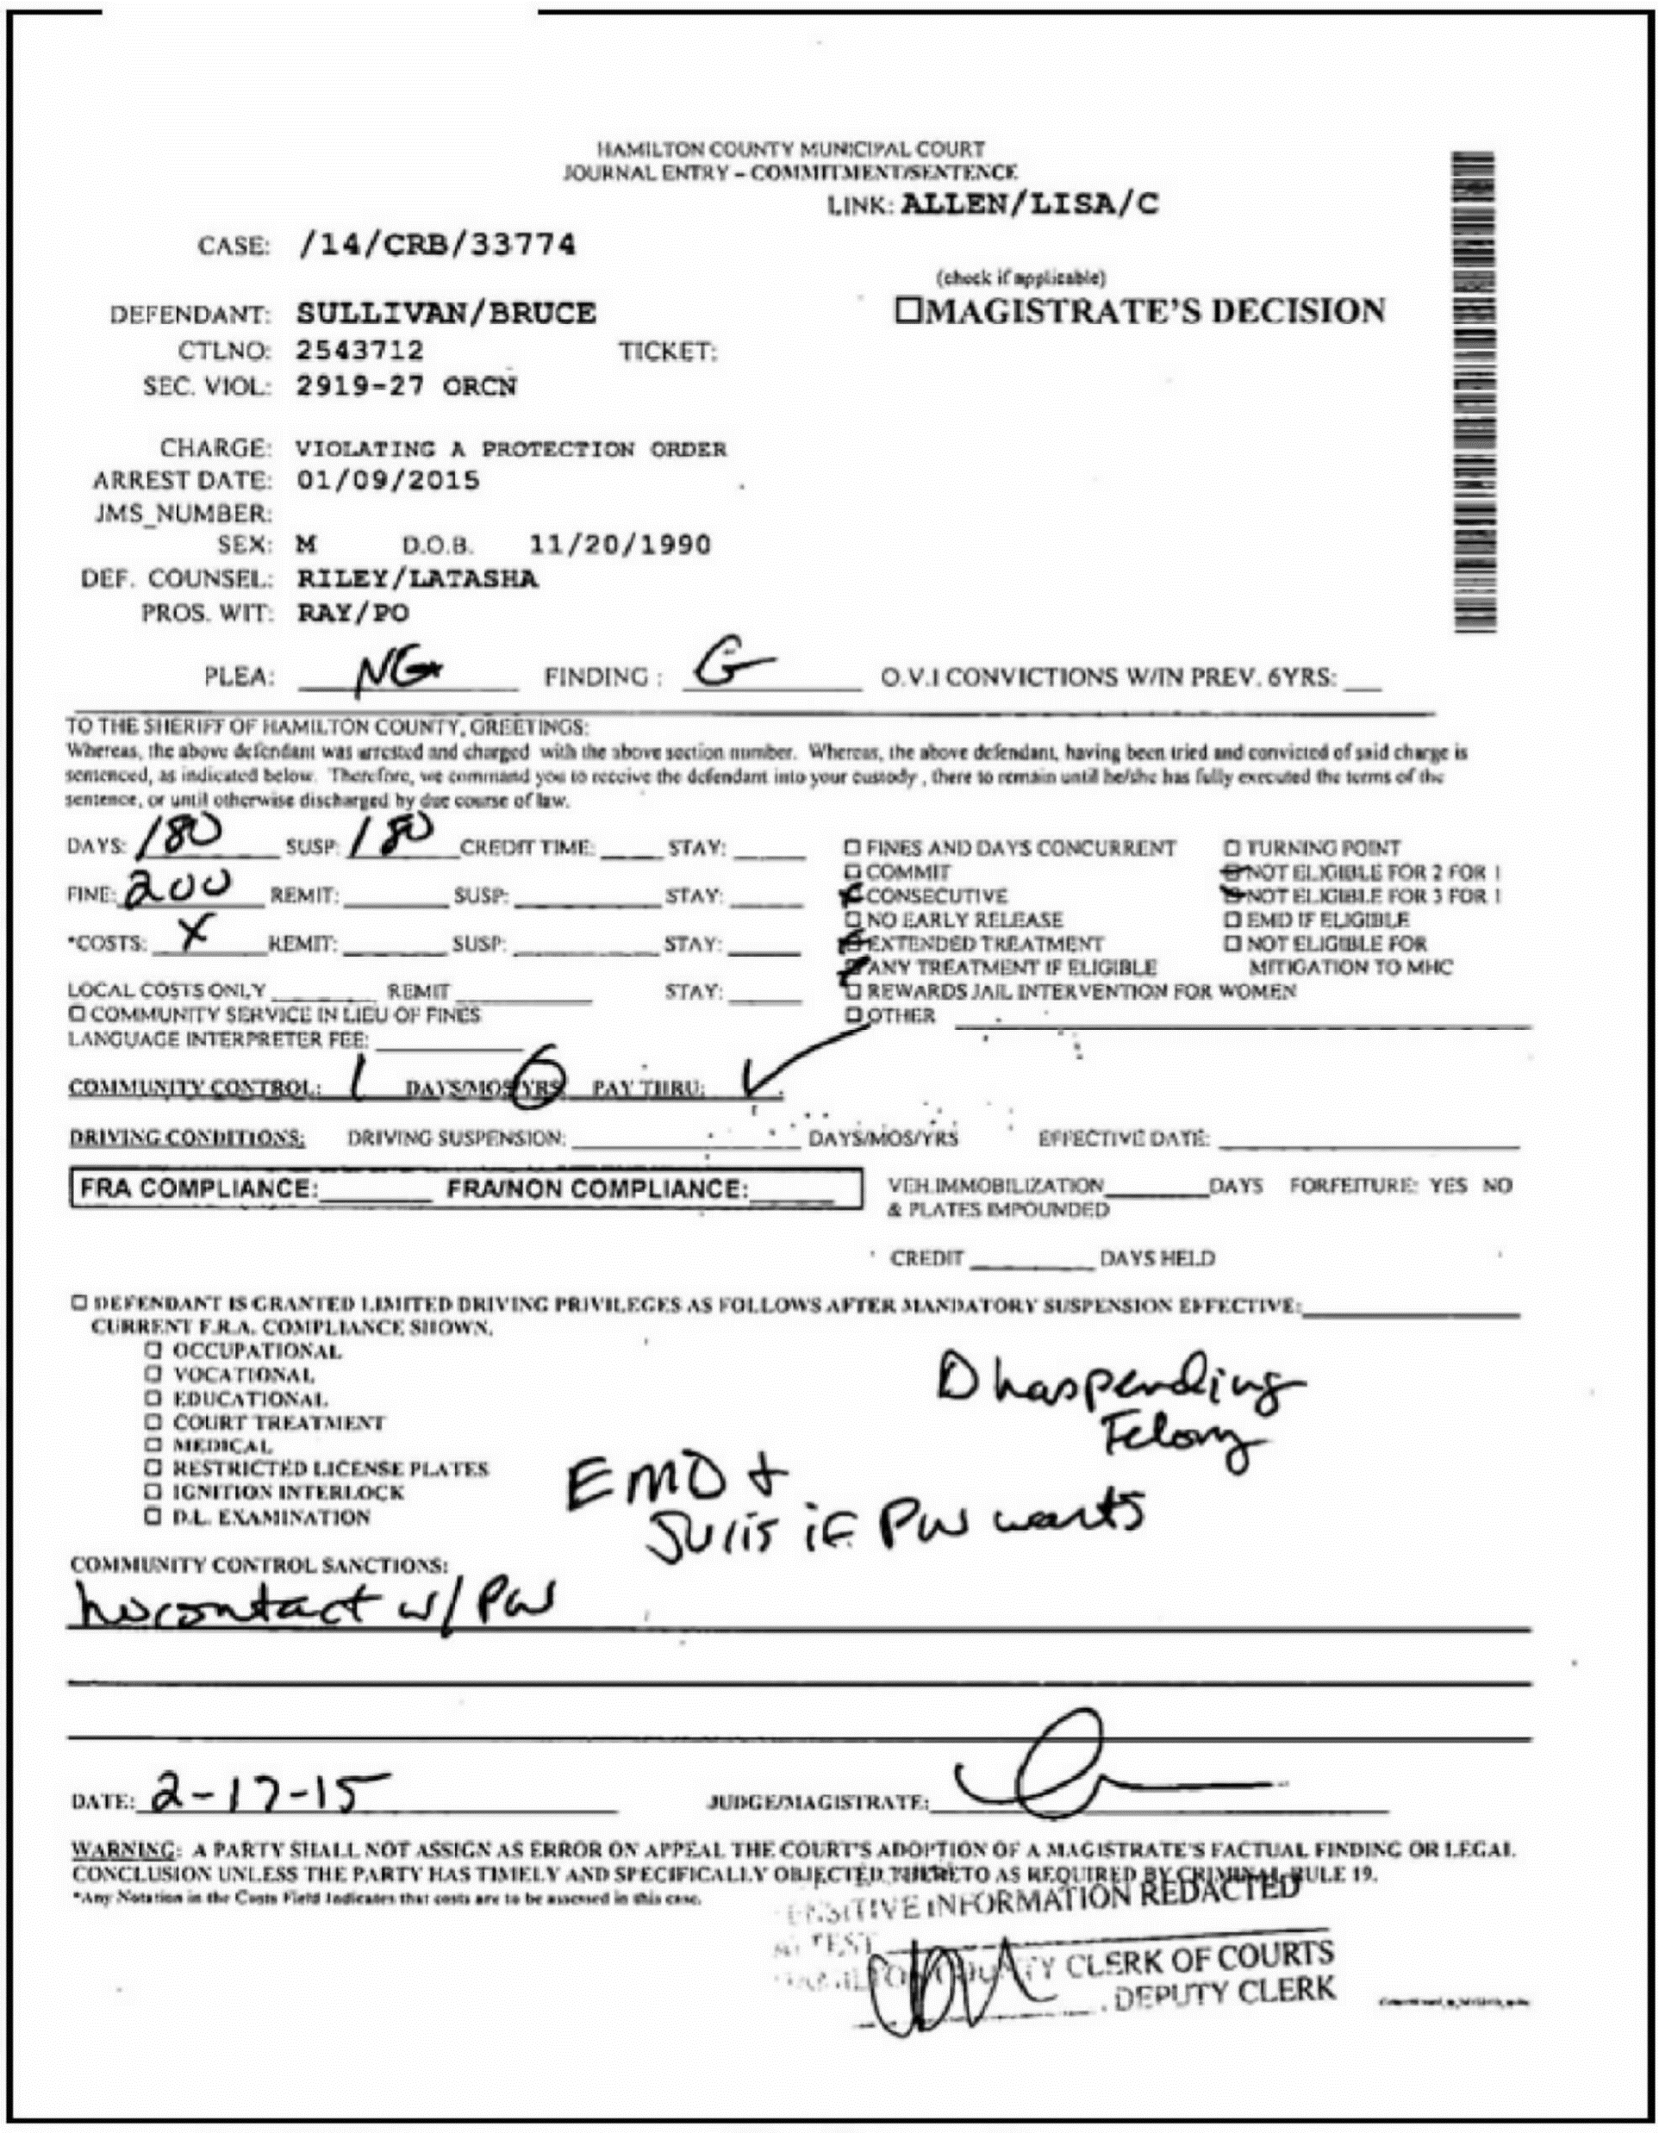
Help the reader understand
Use visual aids:
One of the issues in this case was whether certain markings on the judgment-entry form used by the judge constitute part of the sentence and, thus, were required to be announced in open court in the defendant's presence. State v. Sullivan, 2015-Ohio-4845, ¶ 7 (1st Dist.).
Notes:
This is a First District’s opinion you wrote.

Slide 10
Other visual aids
When comparing statutory provisions
Notes:
This chart is from a merit brief in State v. Bryant before this court. Bryant left the scene of an accident after he stayed there for an hour and the other operator involved in the accident did not call or say she would call the police. Bryant urges the court to compare the two provisions of the Ohio hit-skip statute and find that the first provision does not impose an obligation to call the police or remain at the scene until the police officer arrives.

Slide 11
Help the reader understand
Use heading wisely:
Headings help the reader organize your narrative and understand your key points.
There is little to be gained by: “Argument” or “Facts.” Instead, try: “Smith organizes conspiracy to limit price hikes.”
Use to help the reader understand where you are headed.
Try to keep parallel.

Slide 12
Don’t make it personal
No attacks on opposing counsel.
No attacks on the trial court.
  If the trial court didn’t do its job, explain how it reached the wrong result. But avoid attacks, we can read the record.
Avoid using phrases like it “travesty of justice” or “an insult to intelligence.”
  Very few arguments really merit being called “disingenuous” or “feckless.”
Use exclamation points sparsely; don’t be chicken little.
Avoid naked appeals to sympathy.

Slide 13
Tell the court why it should decide for you
What is the rule you want the court to write? What impact will that rule have in other cases?
What is the policy underlying the precedents you have cited?
Why should the court rely on the cases in your brief?

Slide 14
Writing the introduction
Often the most difficult part to write.
Strive to get the reader’s attention in a way that makes him/her want to keep reading.
At the same time, try to write something that flags immediately what this case is about and what the issue is that the court need decide.

Slide 15
Include the standard of review
Frame your argument in terms of the standard of review.
  Weave the standard of review into your argument.
  People tend to gloss over standalone sections.
  Don’t just serve up boilerplate paragraphs.

Slide 16
Editing
“What I tell my law clerks is that we write these so that they are accessible to regular people. That doesn't mean that there's no law in it. But there are simple ways to put important things in language that's accessible. As I say to them, the beauty, the genius is not to write a 5 cent idea in a ten dollar sentence. It's to put a ten dollar idea in a 5 cent sentence.” — Justice Clarence Thomas

Slide 17
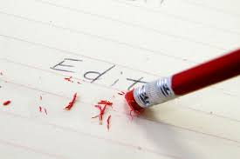
Editing
Primary goal is getting rid of unnecessary things.
Tightly written briefs keep the reader’s attention focused; loosely written briefs cause the reader to skim.
Try printing out a hard copy at least once.

Slide 18
A thought or two on Board of Professional Conduct Opinions
Most opinions do a good job of providing us the information we need
One possible improvement is making sure that the actual language of the rule at issue is prominent in the opinion and tying the facts to the language of the rule

Slide 19
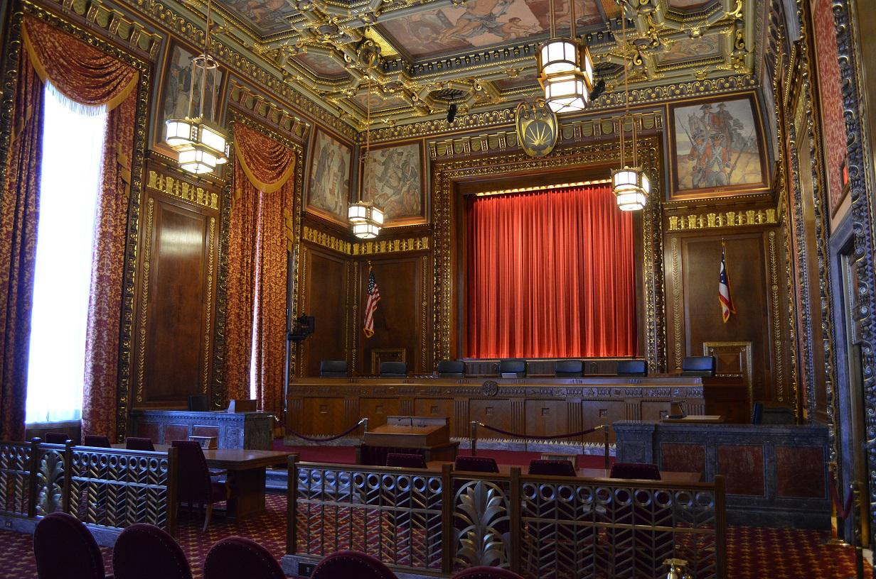
Oral Argument
Your conversation with the Court

Slide 20
Oral Argument Day
Treat oral argument like a conversation
The justices’ questions are more important than your script
Acknowledge weakness
No attacks on opposing counsel
It’s all about preparation. Know your case—facts and law.

Slide 21
Special Considerations for Disciplinary Cases
The factual record
The law
The sanction
Knowing your panel
Disciplinary cases are different!

Slide 22

What happens next?

Slide 23
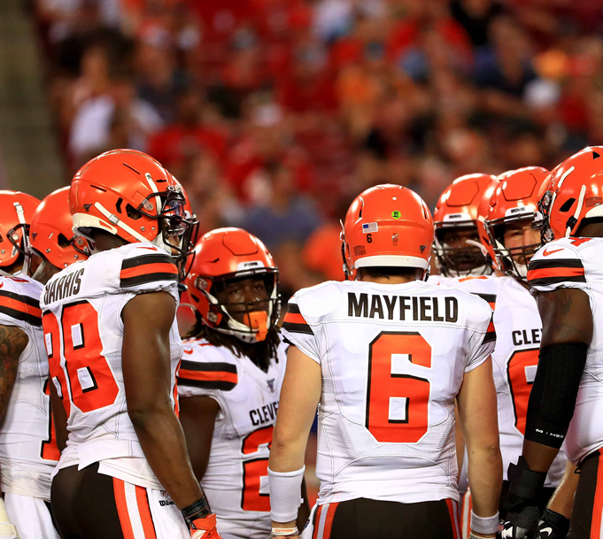
Following oral argument, the justices conference and decide who will write the decision.

Slide 24
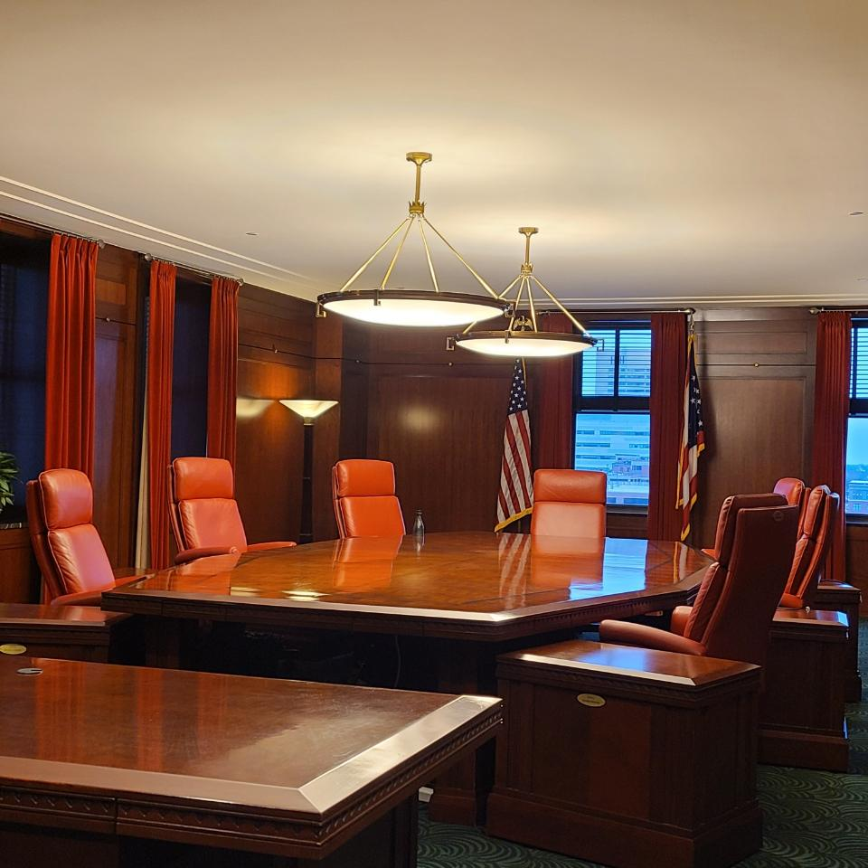
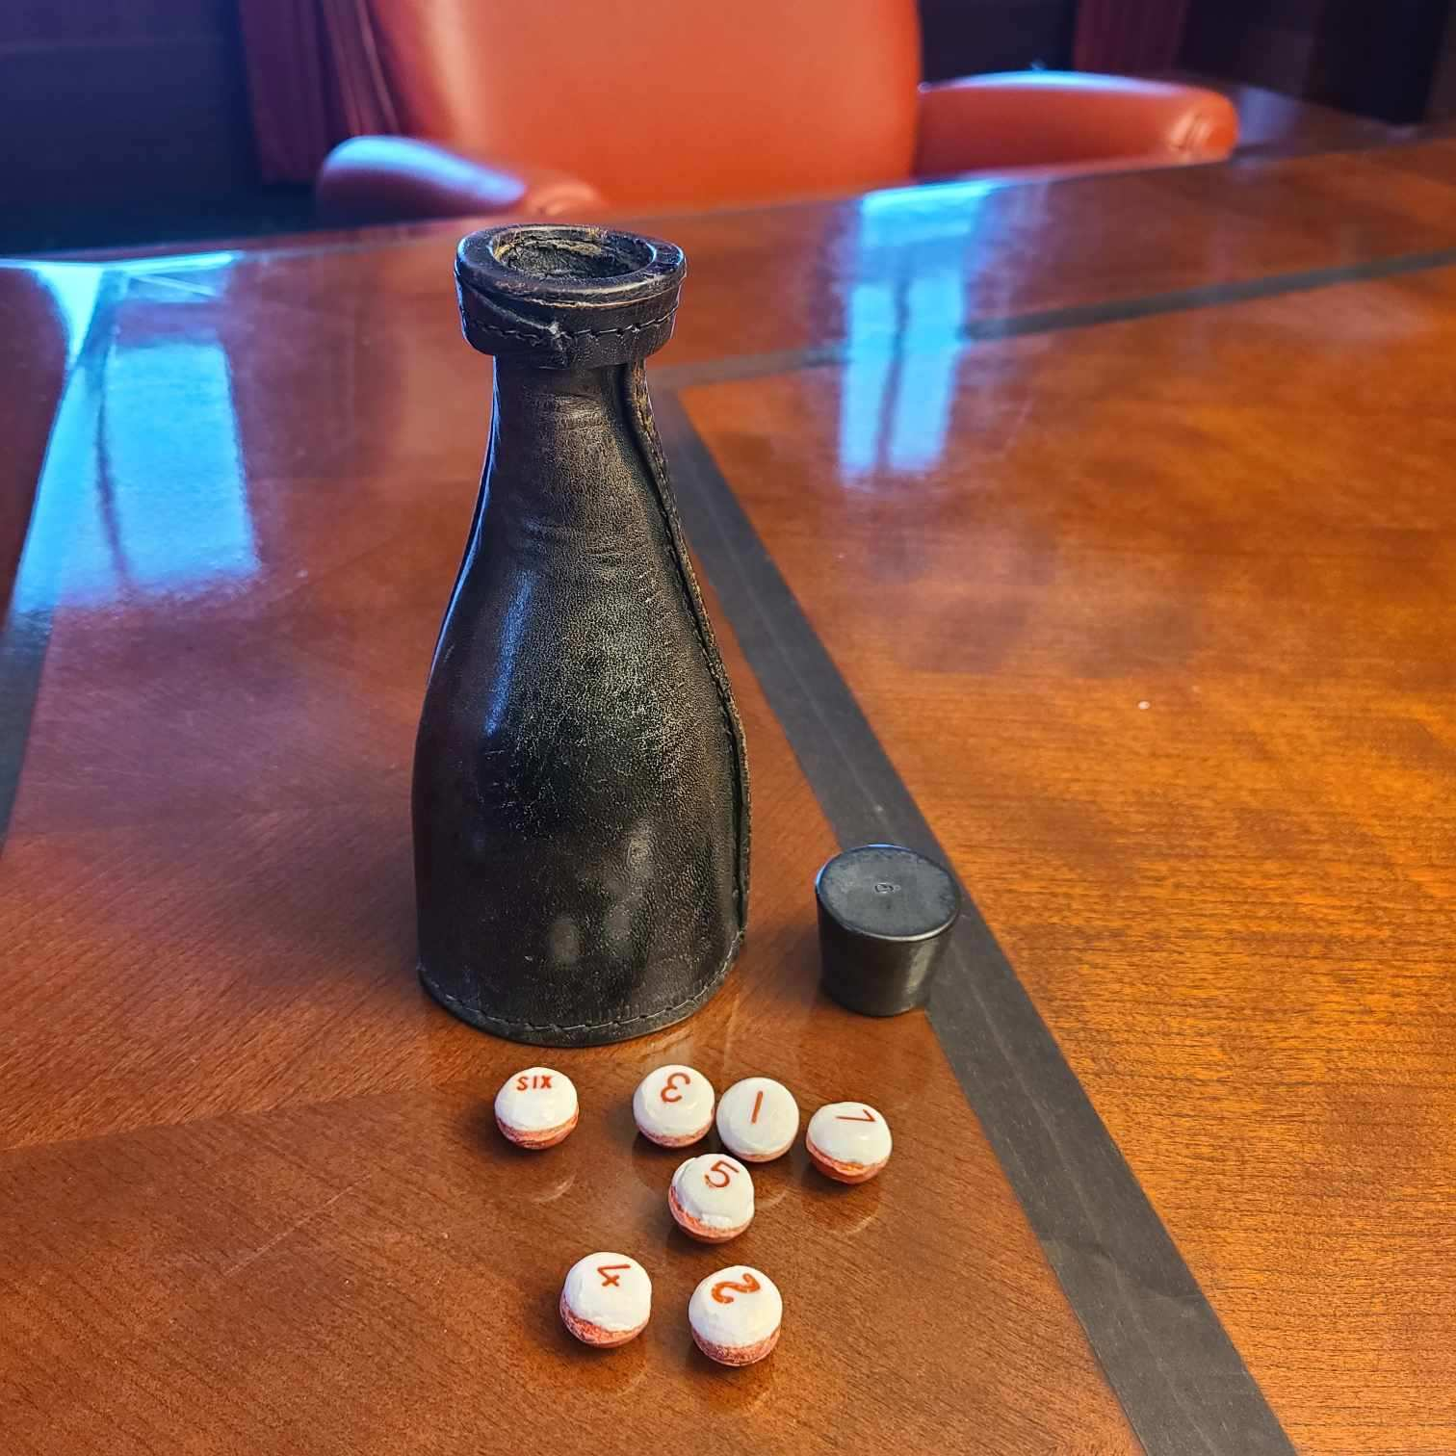

Slide 25
Disciplinary Cases
Court Consideration
The Court Conference
  Questions of law
  Questions of fact
  Deference to the Board
  Sanctions
Preparation of the Opinion
The drafting process
The role of master commissioners
Voting the opinion out

Slide 26
Questions?

Slide 27


Contact me
rpdewine@gmail.com
@patdewine
@JusticePatDeWine

